Slide 1
ENGINEERING GRAPHICS
Topic:
Drawing Instruments

Slide 2
Drawing Instruments
Engineering Drawing is entirely a graphic language.
Drawing equipment and instruments are needed to record
information on drawing paper or any other suitable surface.

Slide 3
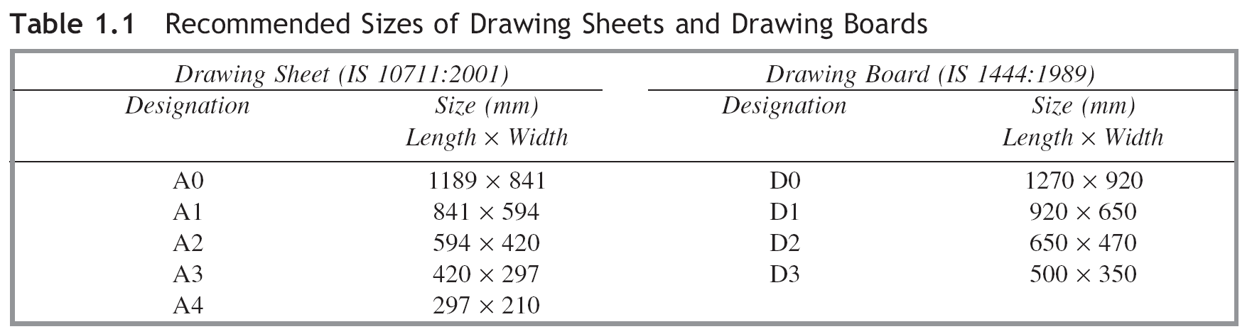
Drawing Instruments
Drawing Sheets
Drawing sheets are the ‘canvases’ on which drawings are composed by pencils. Drawing sheets are available in standard sizes.
Indian Standards (IS) for drawing sheets and drawing boards as recommended by the Bureau of Indian Standards (BIS) are shown in Table 1.1.

Slide 4

Drawing Instruments
1. Grid Sheets:

Slide 5
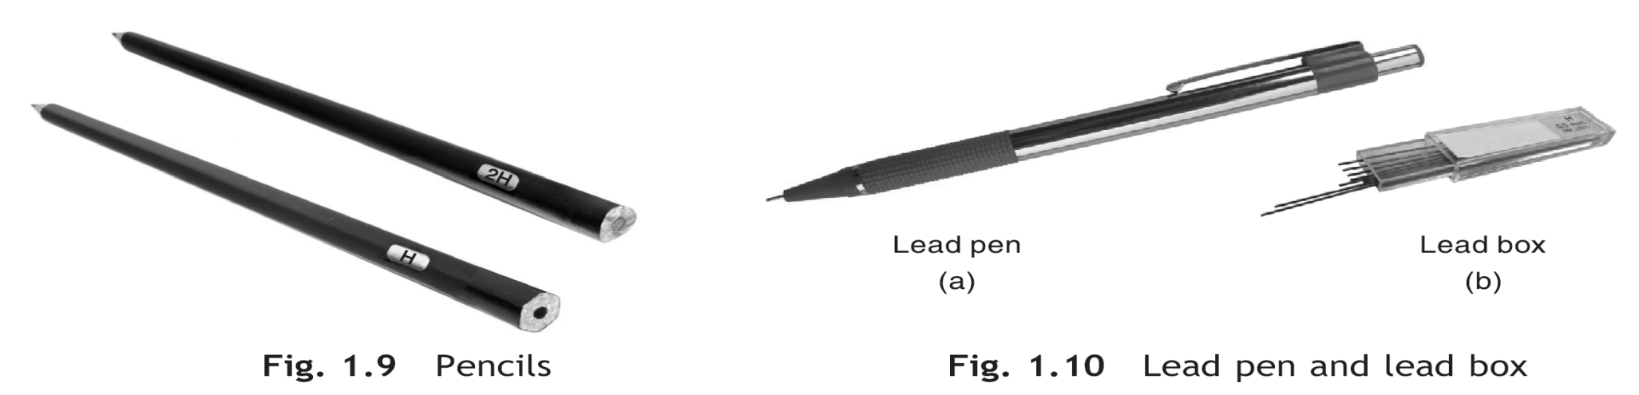
Drawing Instruments
2. Lead Pencil (0.7 mm):
Pencils/Lead Pens
The quality of drawing largely depends on the selection and use of proper grade of pencil. The grade of a pencil is printed near its blocked end.
There are total eighteen grades 9H, 8H, 7H, 6H, 5H, 4H, 3H, 2H, H, F, HB, B, 2B, 3B, 4B, 5B, 6B, 7B. 9H is the hardest and 7B is the softest.
For technical drawing, three grades of pencils, namely, H, 2H and HB are recommended. A lead pen, Fig. 1.10, is an alternative to the pencil.

Slide 6
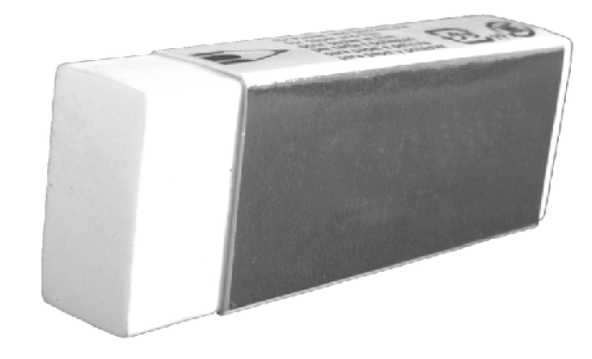
Drawing Instruments
3. Eraser:

Slide 7
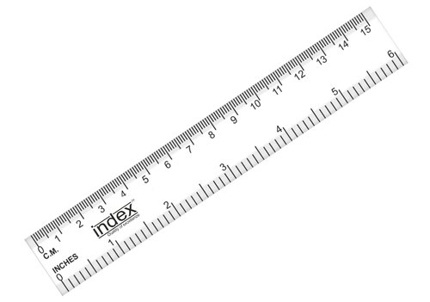
Drawing Instruments
4. Engineering scale 15cm (Plastic):

Slide 8
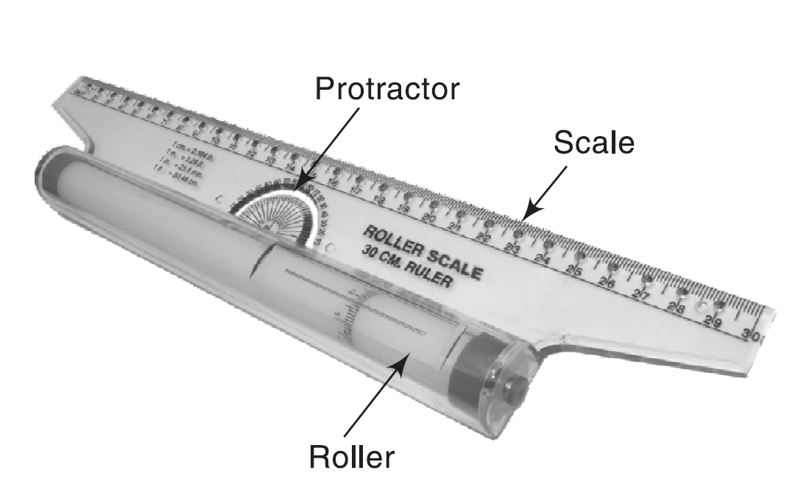
Drawing Instruments
5. Roller Scale 15cm:

Slide 9
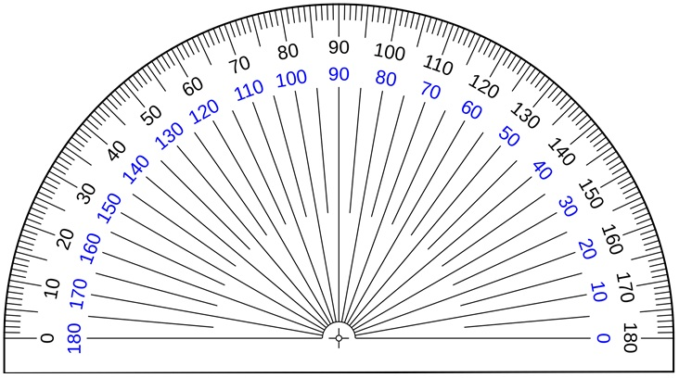
Drawing Instruments
6. Protractor:

Slide 10

Drawing Instruments
7. Compass:

Slide 11
Thanks

